Slide 1
Fundamentals of Machine Learning Final project Joshna Katta 811236826

Slide 2
Problem Statement
Identify a Fuel group which causes less pollution to the Environment based on the sulfur content, ash content and MMBtu per unit.

Slide 3
Data description
Fuel group code
Sulfur content
Ash content
Fuel MMBtu per unit

Slide 4
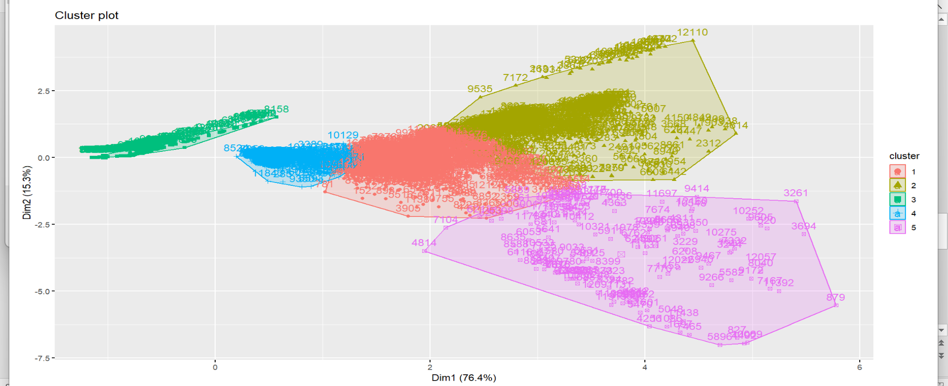
ANALYSIS The technique used is “K-MEANS”

Slide 5
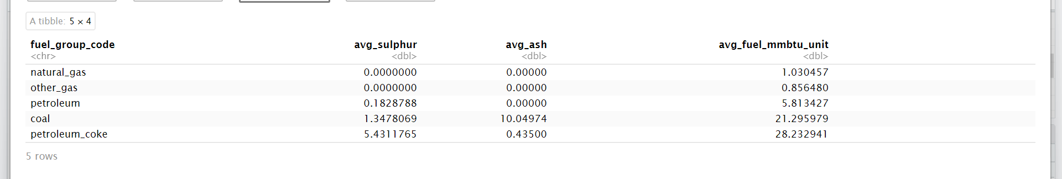

Slide 6
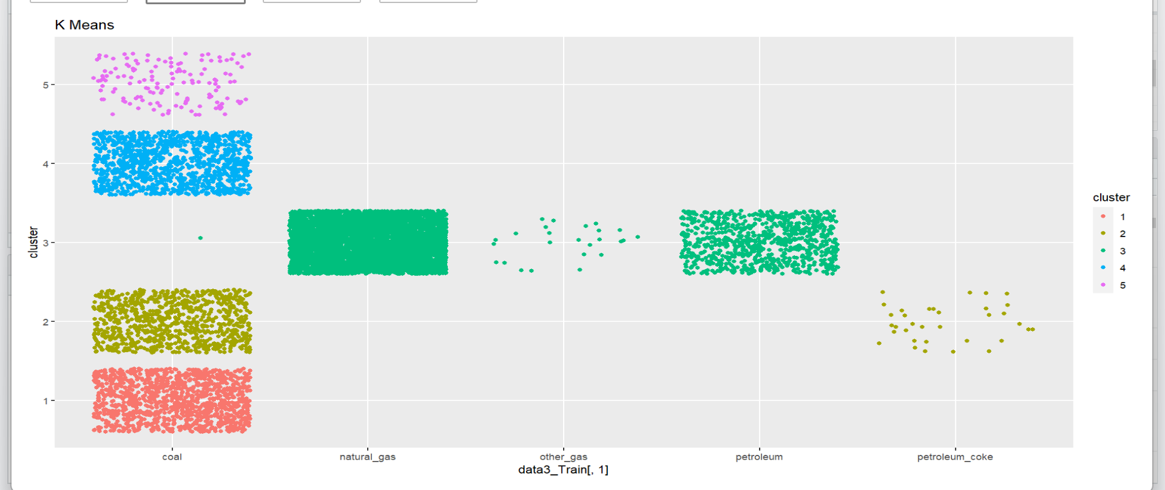

Slide 7
Conclusion
There are four Different types of coals in which one sub-set of coal has same properties as petroleum coke.
Natural gas, other gas and petroleum have similar properties and can categorized into one group.

Slide 8
Summary
We have clustered Fuel groups based on their sulfur, ash and MMBtu per unit.
And cluster 3 is the only cluster with minimum pollutants.
Cluster three has Natural gas, Other gas, and Petroleum.

